Slide 1
Configuration management

Slide 2
Objectives
To explain the importance of software configuration management (CM)
To describe key CM activities namely CM planning, change management, version management and system building
To discuss the use of CASE tools to support configuration management processes

Slide 3
Topics covered
Configuration management planning
Change management
Version and release management
System building
CASE tools for configuration management

Slide 4
Configuration management
New versions of software systems are created as they change:
  For different machines/OS;
  Offering different functionality;
  Tailored for particular user requirements.
Configuration management is concerned with managing evolving software systems:
  System change is a team activity;
  CM aims to control the costs and effort involved in making changes to a system.

Slide 5
Configuration management
Involves the development and application of procedures and standards to manage an evolving software product.
CM may be seen as part of a more general quality management process.
When released to CM, software systems are sometimes called baselines as they are a starting point for further development.

Slide 6
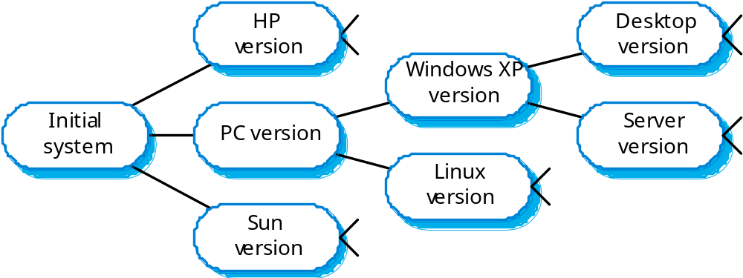
System families

Slide 7
CM standards
CM should always be based on a set of standards which are applied within an organisation.
Standards should define how items are identified, how changes are controlled and how new versions are managed.
Standards may be based on external CM standards (e.g. IEEE standard for CM).
Some existing standards are based on a waterfall process model - new CM standards are needed for evolutionary development.

Slide 8
Concurrent development and testing
A time (say 2pm) for delivery of system components is agreed.
A new version of a system is built from these components by compiling and linking them.
This new version is delivered for testing using pre-defined tests.
Faults that are discovered during testing are documented and returned to the system developers.

Slide 9
Frequent system building
It is easier to find problems that stem from component interactions early in the process.
This encourages thorough unit testing - developers are under pressure not to ‘break the build’.
A stringent change management process is required to keep track of problems that have been discovered and repaired.

Slide 10
Configuration management planning
All products of the software process may have to be managed:
  Specifications;
  Designs;
  Programs;
  Test data;
  User manuals.
Thousands of separate documents may be
generated for a large, complex software system.

Slide 11
The CM plan
Defines the types of documents to be managed and a document naming scheme.
Defines who takes responsibility for the CM procedures and creation of baselines.
Defines policies for change control and version management.
Defines the CM records which must be maintained.

Slide 12
The CM plan
Describes the tools which should be used to assist the CM process and any limitations on their use.
Defines the process of tool use.
Defines the CM database used to record configuration information.
May include information such as the CM of external software, process auditing, etc.

Slide 13
Configuration item identification
Large projects typically produce thousands of documents which must be uniquely identified.
Some of these documents must be maintained for the lifetime of the software.
Document naming scheme should be defined
so that related documents have related names.
A hierarchical scheme with multi-level names is
probably the most flexible approach.
  PCL-TOOLS/EDIT/FORMS/DISPLAY/AST-INTERFACE/CODE

Slide 14
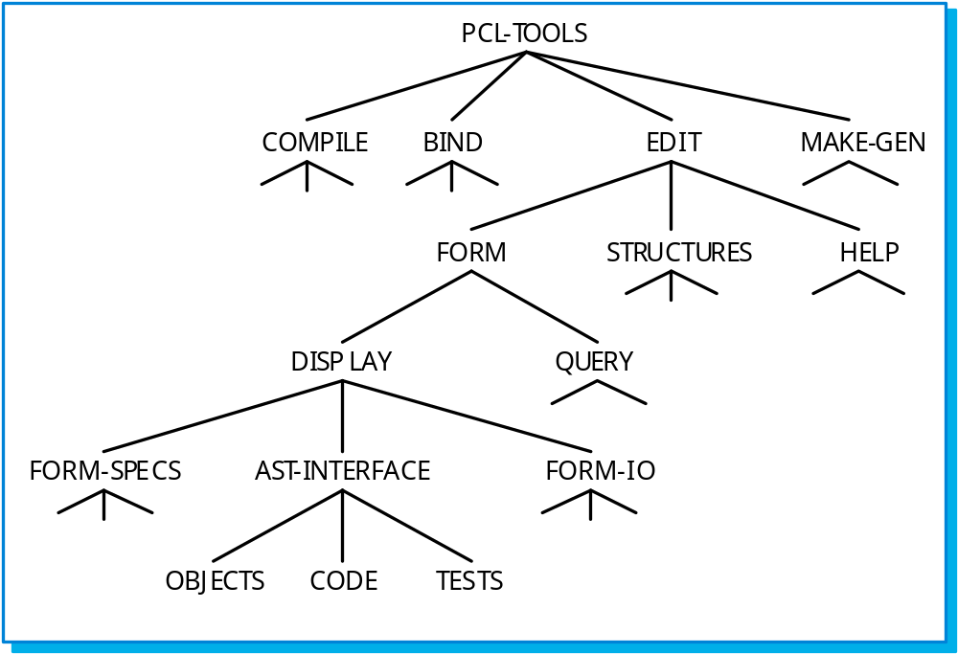
Configuration hierarchy

Slide 15
The configuration database
All CM information should be maintained in a
configuration database.
This should allow queries about configurations to be
answered:
  Who has a particular system version?
  What platform is required for a particular version?
  What versions are affected by a change to component X?
  How many reported faults in version T?
The CM database should preferably be linked to the software being managed.

Slide 16
CM database implementation
May be part of an integrated environment to support software development.
  The CM database and the managed documents are all maintained on the same system
CASE tools may be integrated with this so that there is a close relationship between the CASE tools and the CM tools.
More commonly, the CM database is maintained separately as this is cheaper and more flexible.

Slide 17
Change management
Software systems are subject to continual
change requests:
  From users;
  From developers;
  From market forces.
Change management is concerned with keeping track of these changes and ensuring that they are implemented in the most cost-effective way.

Slide 18
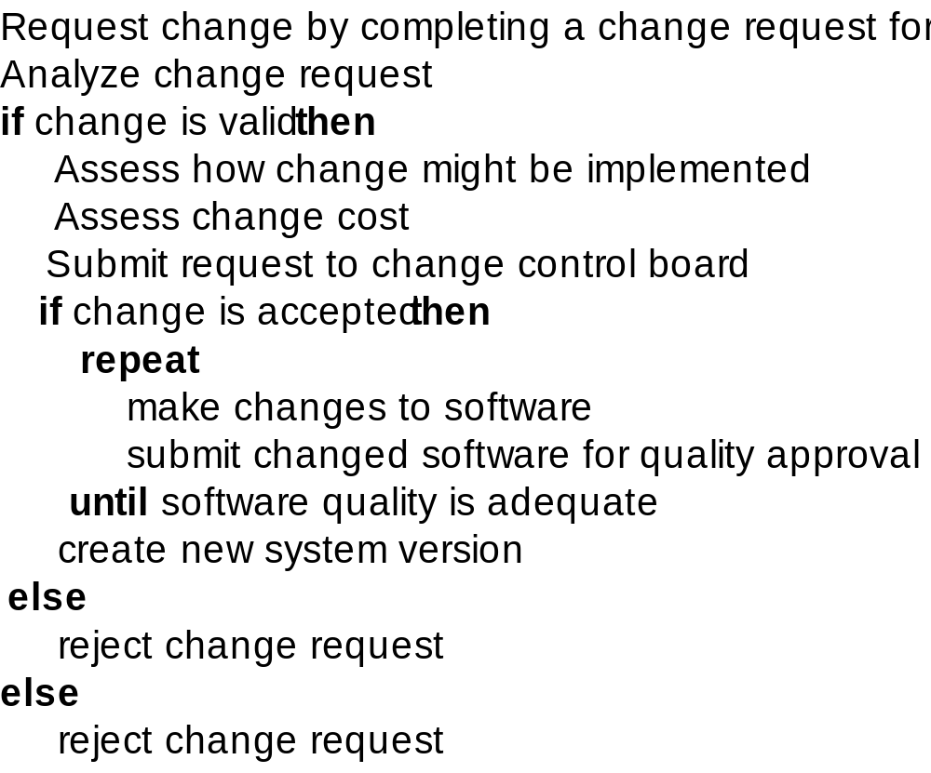
The change management process

Slide 19
Change request form
The definition of a change request form is part of the
CM planning process.
This form records the change proposed, requestor of change, the reason why change was suggested and the urgency of change(from requestor of the
change).
It also records change evaluation, impact analysis,
change cost and recommendations (System
maintenance staff).

Slide 20
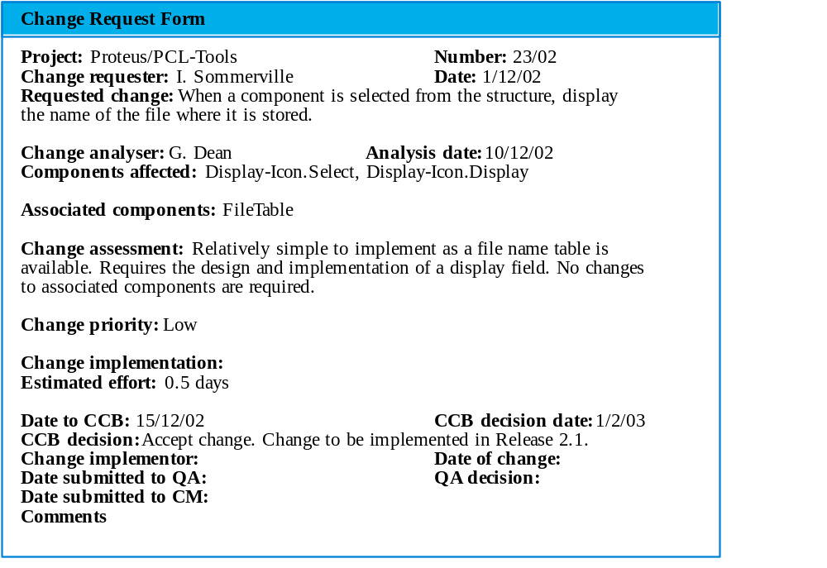
Change request form

Slide 21
Change tracking tools
A major problem in change management is
tracking change status.
Change tracking tools keep track the status of each change request and automatically ensure that change requests are sent to the right people at the right time.
Integrated with E-mail systems allowing
electronic change request distribution.

Slide 22
Change control board
Changes should be reviewed by an external group who decide whether or not they are cost-effective from a strategic and organizational viewpoint rather than a technical viewpoint.
Should be independent of project responsible
for system. The group is sometimes called a change control board.
The CCB may include representatives from client and contractor staff.

Slide 23
Derivation history
This is a record of changes applied to a document or code component.
It should record, in outline, the change made, the rationale for the change, who made the change and when it was implemented.
It may be included as a comment in code. If a standard prologue style is used for the derivation history, tools can process this automatically.

Slide 24
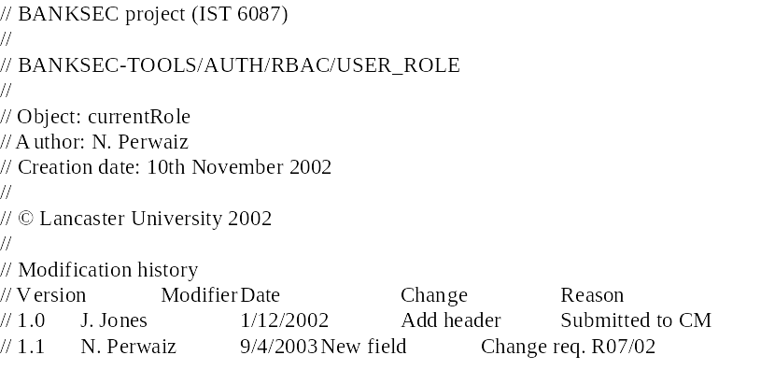
Component header information

Slide 25
Version and release management
Invent an identification scheme for system
versions.
Plan when a new system version is to be
produced.
Ensure that version management procedures and tools are properly applied.
Plan and distribute new system releases.

Slide 26
Versions/variants/releases
Version An instance of a system which is
functionally distinct in some way from other
system instances.
Variant An instance of a system which is
functionally identical but non-functionally
distinct from other instances of a system.
Release An instance of a system which is
distributed to users outside of the development team.

Slide 27
Version identification
Procedures for version identification should define an unambiguous way of identifying component versions.
There are three basic techniques for component identification
  Version numbering;
  Attribute-based identification;
  Change-oriented identification.

Slide 28
Version numbering
Simple naming scheme uses a linear derivation
  V1, V1.1, V1.2, V2.1, V2.2 etc.
The actual derivation structure is a tree or a
network rather than a sequence.
Names are not meaningful.
A hierarchical naming scheme leads to fewer errors in version identification.

Slide 29
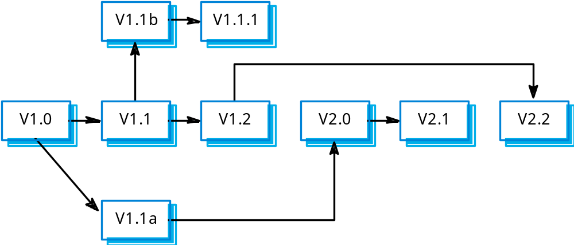
Version derivation structure

Slide 30
Attribute-based identification
Attributes can be associated with a version with
the combination of attributes identifying that
version
  Examples of attributes are Date, Creator,
  Programming Language, Customer, Status etc.
This is more flexible than an explicit naming scheme
for version retrieval; However, it can cause problems with uniqueness - the set of attributes have to be chosen so that all versions can be uniquely identified.
In practice, a version also needs an associated name for easy reference.

Slide 31
Attribute-based queries
An important advantage of attribute-based identification is that it can support queries so that you can find ‘the most recent version in Java’ etc.
The query selects a version depending on attribute values
  AC3D (language =Java, platform = XP, date = Jan 2003).

Slide 32
Change-oriented identification
Integrates versions and the changes made to create these versions.
Used for systems rather than components.
Each proposed change has a change set that describes changes made to implement that change.
Change sets are applied in sequence so that, in principle, a version of the system that incorporates an arbitrary set of changes may be created.

Slide 33
Release management
Releases must incorporate changes forced on the system by errors discovered by users and by hardware changes.
They must also incorporate new system
functionality.
Release planning is concerned with when to
issue a system version as a release.

Slide 34
System releases
Not just a set of executable programs.
May also include:
  Configuration files defining how the release is configured for a particular installation;
  Data files needed for system operation;
  An installation program or shell script to install the system on target hardware;
  Electronic and paper documentation;
  Packaging and associated publicity.
Systems are now normally released on optical disks (CD or DVD) or as downloadable installation files from the web.

Slide 35
Release problems
Customer may not want a new release of the
system
  They may be happy with their current system as the new version may provide unwanted functionality.
Release management should not assume that all previous releases have been accepted. All files required for a release should be re-created when a new release is installed.

Slide 36
Release decision making
Preparing and distributing a system release is an expensive process.
Factors such as the technical quality of the system, competition, marketing requirements and customer change requests should all influence the decision of when to issue a new system release.

Slide 37
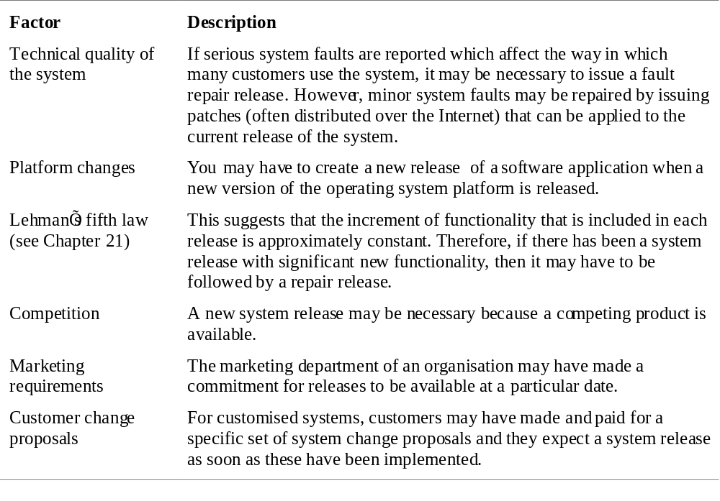
System release strategy

Slide 38
Release creation
Release creation involves collecting all files and documentation required to create a system release.
Configuration descriptions have to be written for different hardware and installation scripts have to be written.
The specific release must be documented to record exactly what files were used to create it. This allows it to be re-created if necessary.

Slide 39
System building
The process of compiling and linking software components into an executable system.
Different systems are built from different
combinations of components.
This process is now always supported by automated tools that are driven by ‘build scripts’.

Slide 40
System building problems
Do the build instructions include all required
components?
  When there are many hundreds of components making up
  a system, it is easy to miss one out. This should normally
  be detected by the linker.
Is the appropriate component version
specified?
  A more significant problem. A system built with the wrong
  version may work initially but fail after delivery.
Are all data files available?
  The build should not rely on 'standard' data files. Standards
  vary from place to place.

Slide 41
System building problems
Are data file references within components
correct?
  Embedding absolute names in code almost always causes
  problems as naming conventions differ from place to place.
Is the system being built for the right platform
  Sometimes you must build for a specific OS version or hardware configuration.
Is the right version of the compiler and other
software tools specified?
  Different compiler versions may actually generate different code and the compiled component will exhibit different behaviour.

Slide 42
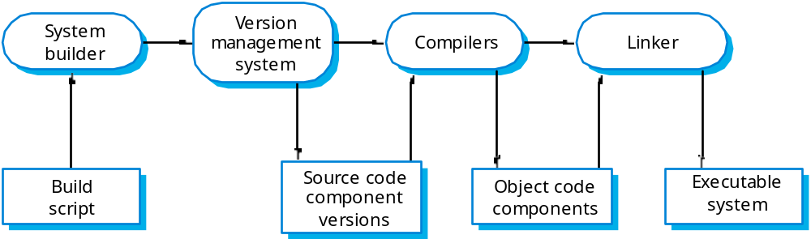
_x0008_System building

Slide 43
CASE tools for configuration management
CM processes are standardised and involve applying pre-defined procedures.
Large amounts of data must be managed.
CASE tool support for CM is therefore essential.
Mature CASE tools to support configuration management are available ranging from stand-alone tools to integrated CM workbenches.

Slide 44
CM workbenches
Open workbenches
  Tools for each stage in the CM process are integrated through organisational procedures and scripts. Gives flexibility in tool selection.
Integrated workbenches
  Provide whole-process, integrated support for configuration management. More tightly integrated tools so easier to use. However, the cost is less flexibility in the tools used.

Slide 45
Change management tools
Change management is a procedural process so it can be modelled and integrated with a version management system.
Change management tools
  Form editor to support processing the change request forms;
  Workflow system to define who does what and to automate information transfer;
  Change database that manages change proposals and is linked to a VM system;
  Change reporting system that generates management reports on the status of change requests.

Slide 46
Version management tools
Version and release identification
  Systems assign identifiers automatically when a new version is submitted to the system.
Storage management.
  System stores the differences between versions rather than all the version code.
Change history recording
  Record reasons for version creation.
Independent development
  Only one version at a time may be checked out for change. Parallel working on different versions.
Project support
  Can manage groups of files associated with a project rather than just single files.

Slide 47
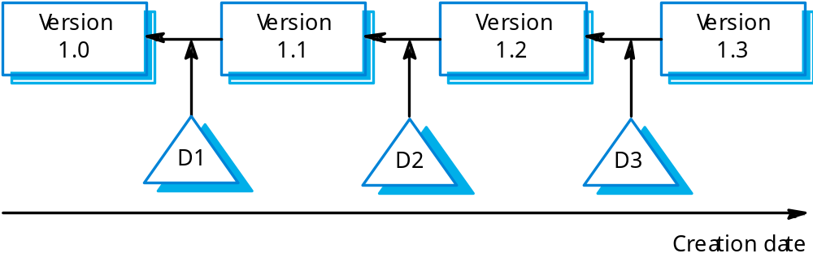
Delta-based versioning

Slide 48
System building
Building a large system is computationally expensive and may take several hours.
Hundreds of files may be involved.
System building tools may provide
  A dependency specification language and interpreter;
  Tool selection and instantiation support;
  Distributed compilation;
  Derived object management.

Slide 49
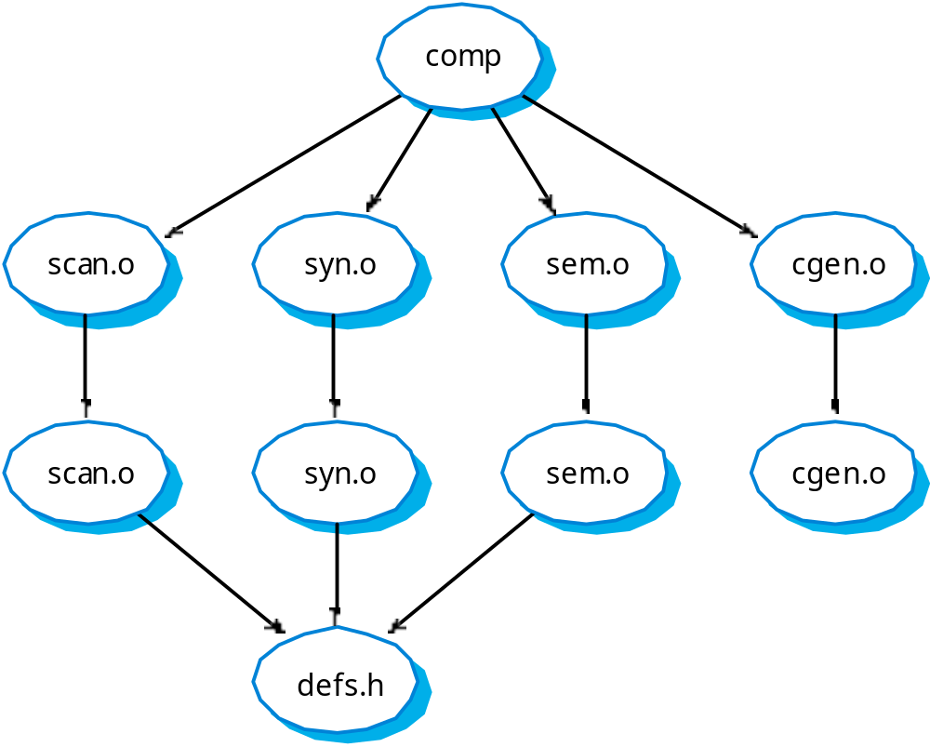
Component dependencies

Slide 50
Key points
Configuration management is the management of system change to software products.
A formal document naming scheme should be
established and documents should be managed in a database.
The configuration data base should record information about changes and change requests.
A consistent scheme of version identification should be established using version numbers, attributes or change sets.

Slide 51
Key points
System releases include executable code, data, configuration files and documentation.
System building involves assembling components into a system..
CASE tools are available to support all CM activities
CASE tools may be stand-alone tools or may be integrated systems which integrate support for version management, system building and change management.

